Slide 1
Image Genetic
Jointly test the association between clinical disorder, genetic and neurologic markers

Slide 2
General Hypothesis
CNS disorder
Brain
Others
Genome
Clinical
Profile
Neurologic
Profile
Other
Profiles
WGS
Profile
Notes:
Up: concept view
Lower: data view

Slide 3
The Data of interest
Structure based
Event based
Genetics
Neurologic
Non NGS
NGS
MRI
SNV
Non SNV
Classical Marker
EGG …
Others
Interchangeable terms:
Genetic data, sequencing data, SNP(s), SNV(s), or variants
Neurologic data, Image data, MRI data, or images
Notes:
From now on I’ll focus on NGS data and structure data

Slide 4
Sampling machineries
Genetic
Neurologic
Magnetic Resonance Image (MRI)
Next Generation Sequencing (NGS)
Notes:
Genetic information: Sampling machinery - DNA sequencing equipment: Ilumina
raw information – nucleotide sequence
analytical ready data – variable nucleotide among the study population
Neurologic:
MRI: Magnetic Resonance Image
EGG:
format – brain structure

Slide 5
Image processing pipeline

Slide 6
General Image processing
Intensity
analysis
surface
analysis
Raw Slices
Voxel
Vertex
Label
MRI
PROC
RECON
SEG
Notes:
Seg: segmentation

Slide 7
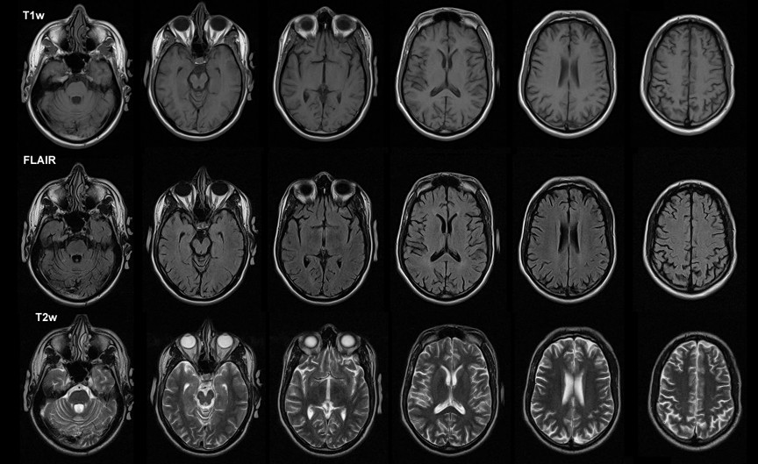
Neurologic Data: MRI Slices
Notes:
Genetic information: Sampling machinery - DNA sequencing equipment: Ilumina
raw information – nucleotide sequence
analytical ready data – variable nucleotide among the study population
Neurologic:
MRI: Magnetic Resonance Image
EGG:
format – brain structure

Slide 8
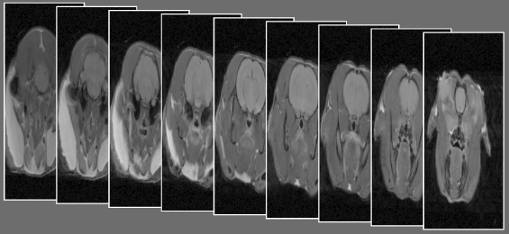
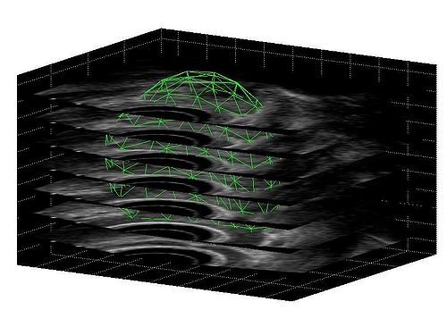
Neurologic Data: MRI Slices
Notes:
Genetic information: Sampling machinery - DNA sequencing equipment: Ilumina
raw information – nucleotide sequence
analytical ready data – variable nucleotide among the study population
Neurologic:
MRI: Magnetic Resonance Image
EGG:
format – brain structure

Slide 9
General Image processing
Intensity
analysis
Surf, Vol
analysis
ROI
Analysis
Slices
Voxel
Surface & Volume
Labels
MRI
PROC
RECON
SEG

Slide 10
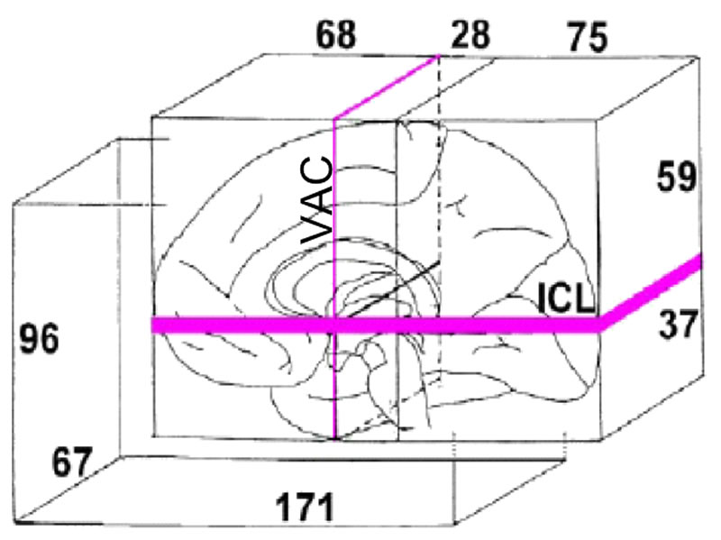
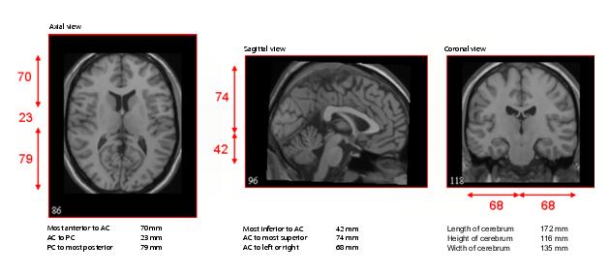
PROC : Align to Talairach Space
map the location of brain structures independent from individual differences in the size and overall shape

Slide 11
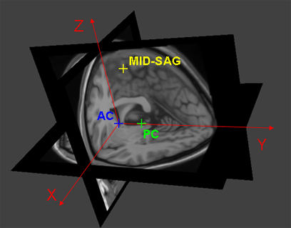
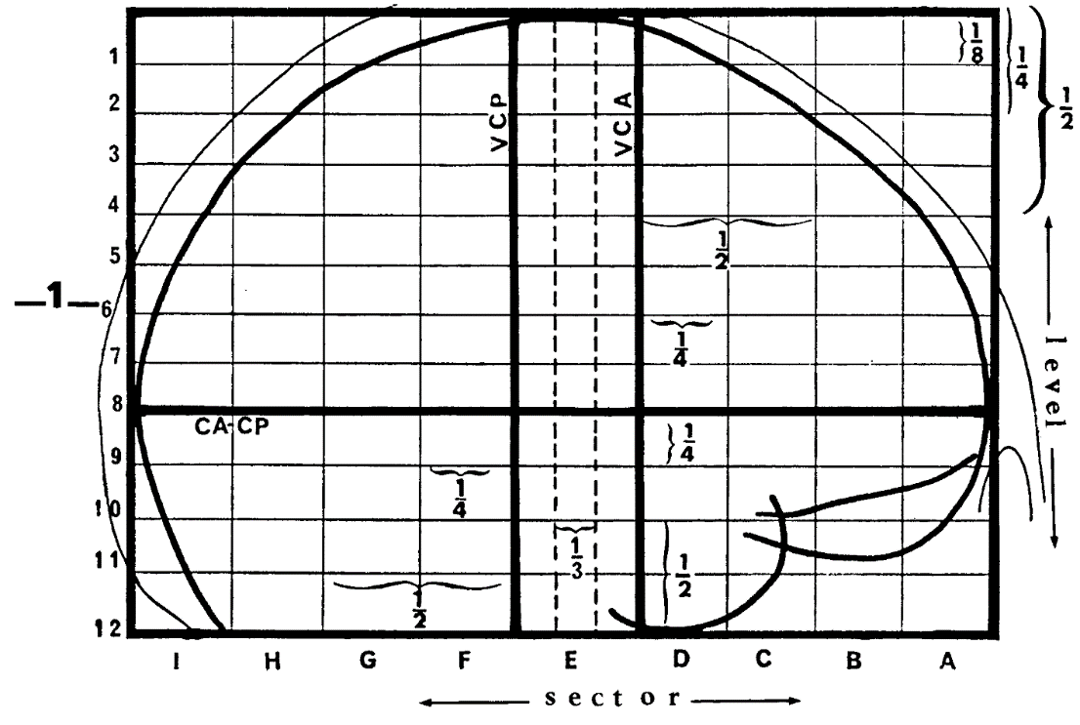
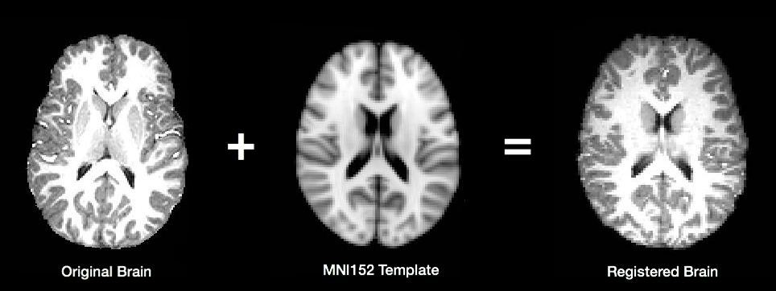
PROC : Align to Talairach Space

Slide 12
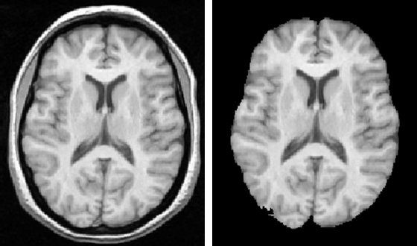
PROC: Skull Striping

Slide 13
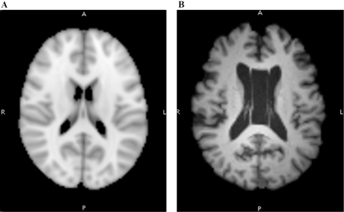
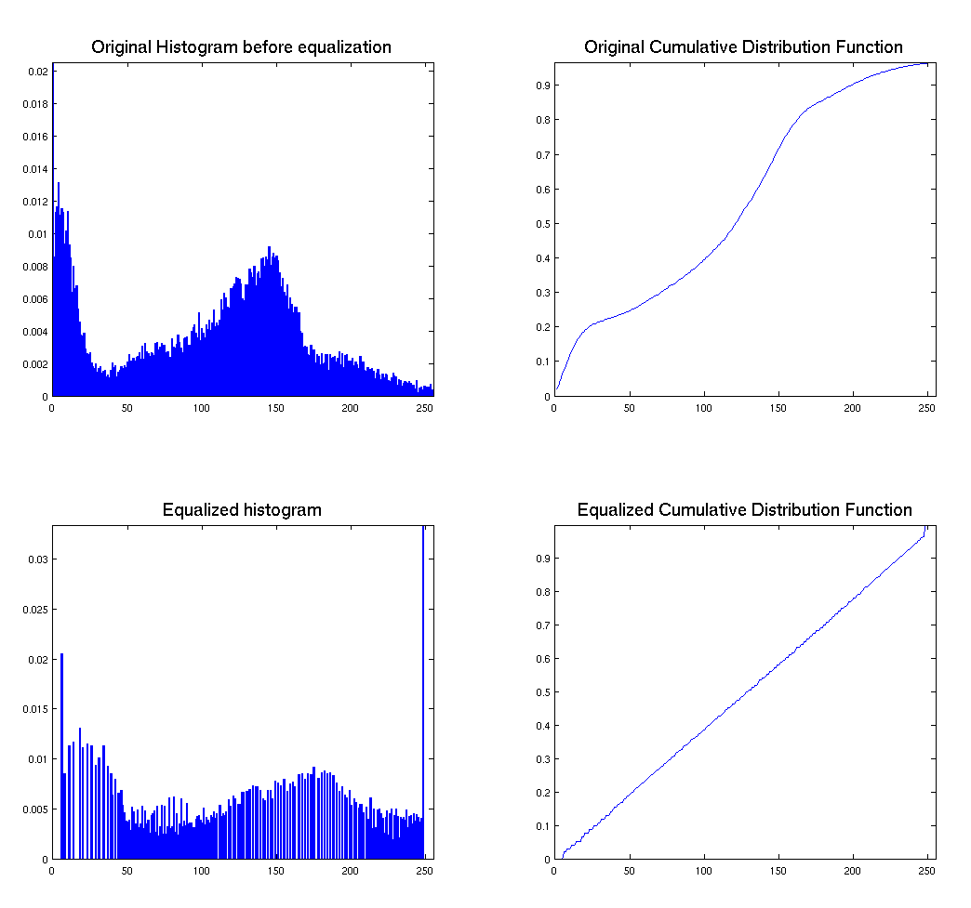
PORC: Intensity Normalization

Slide 14
General Image processing
Intensity
analysis
Surf, Vol
analysis
ROI
Analysis
Raw Slices
Voxel
Intensity
Surface & Volume
Labels
MRI
PROC
RECON
SEG
Notes:
ROI: region of interest
SEG: segmentation

Slide 15
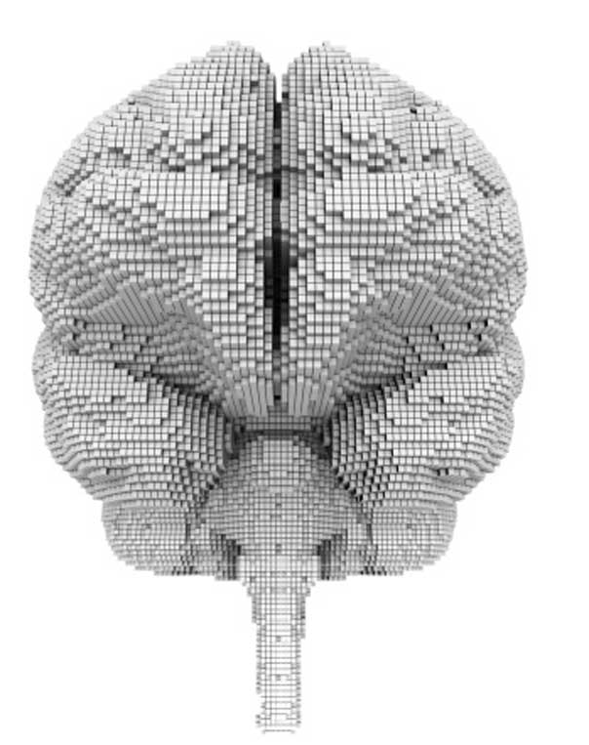
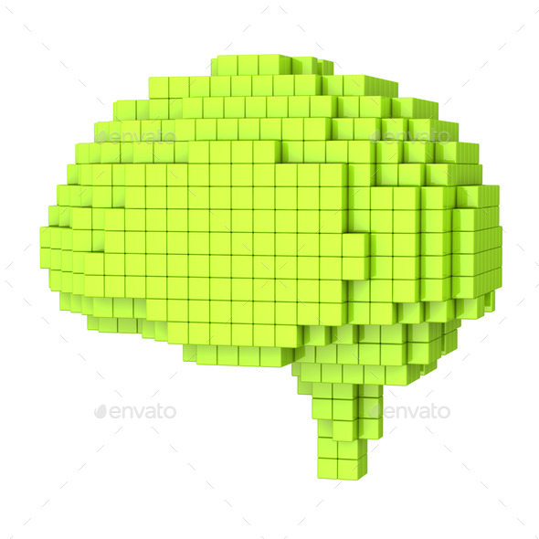
Neurologic Data: Voxels
Slices and voxels are interchangeable
Notes:
Genetic information: Sampling machinery - DNA sequencing equipment: Ilumina
raw information – nucleotide sequence
analytical ready data – variable nucleotide among the study population
Neurologic:
MRI: Magnetic Resonance Image
EGG:
format – brain structure

Slide 16
Terms
Slices and voxels are interchangeable
Both carry intensity information
Intensity is the brightness of MRI scan at:
Each pixel in each slices
Or Each voxel
These terms are interchangeable:
Slice data and voxel data
Intensity data, voxel intensity, and simply intensity

Slide 17
Intensity based association analysis
Covariant:
Voxel intensity, in gray scale unit
Genetic variants
Response:
clinical sign and symptoms
Test association
Brutally test every non-black voxel
Advanced test considering local correlation

Slide 18
Rationale of Intensity analysis
Voxel intensity encodes tissue type
Pitch black: non - tissue
Darker: skull or CSF
Moderate: gray matter
Bright: white matter and subcortical structures
Within the brighter part
subcortical structures exhibit different voxel brightness distribution
Notes:
White matter: brightest
Gray matter: less bright
Skull and CSF: darker
Empty space: pitch black

Slide 19
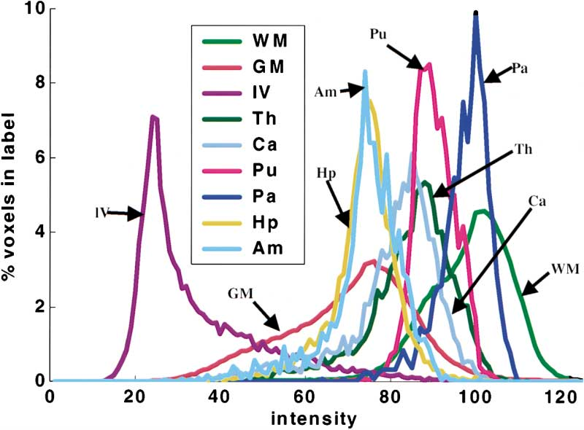
Intensity Histograms
White Matter (WM)
Gray Matter (GM)
Lateral Ventricle (lV)
Thalamus (Th)
Caudate (Ca),
Putamen (Pu)
Pallidum (Pa)
Hippocampus (Hp)
Amygdala (Am)
Notes:
Should mention the partially overlapping histogram of GM and WM

Slide 20
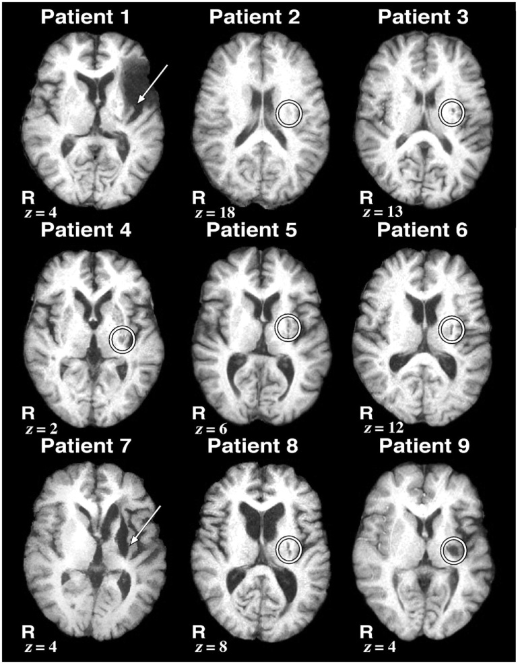
Voxel intensity as a predictor
CNS disorder
Brain morph
MRI Intensity
Others
Genetic
Clinical Profile
Voxel
Intensity
Others
WGS
Profiles

Slide 21
Image processing
Intensity
analysis
Surface
analysis
ROI
Analysis
Raw Slices
Voxels
Vertices
Labels
MRI
PROC
RECON
PAC
RECON = Surface reconstruction guided by intensity

Slide 22
RECON Pipeline
Boundary search
Voxel intensity guided WM and GM boundary search
Tessellation
Triangulate boundary voxels → 3D Surface Vertices
Registration
Collect Data 1
Collect Data 2
Smoot 3D surface
Unify vertex count and sequence
3D to 2D space

Slide 23
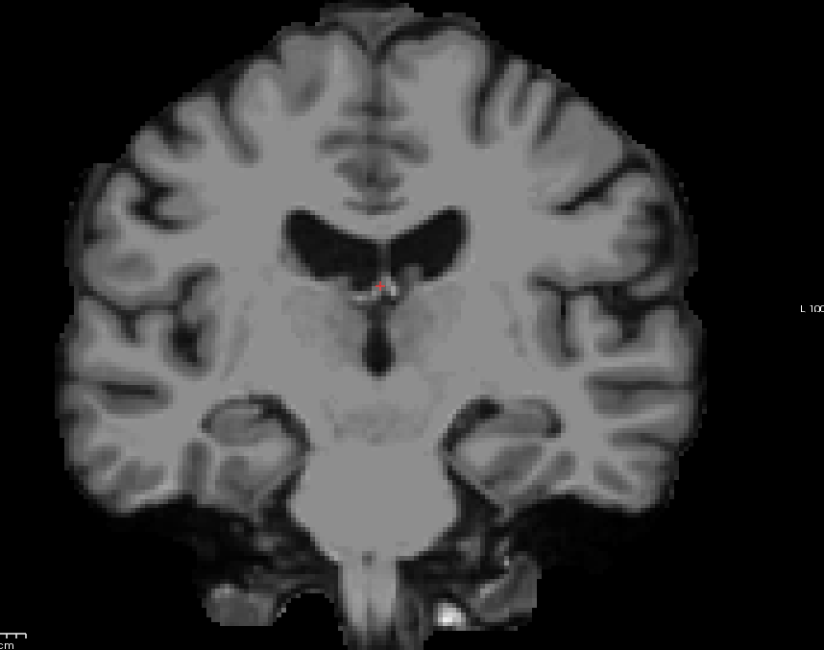
RECON: Find surface boundaries
Starts with skull stripped and intensity normalized voxel data

Slide 24
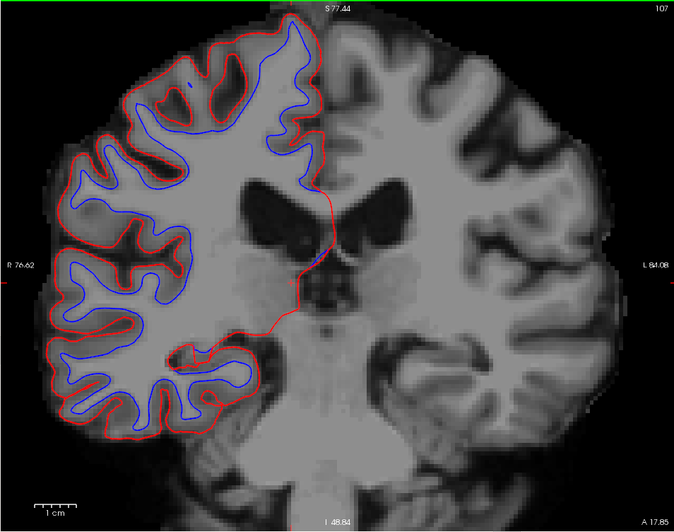
Intensity guided boundary search
–– Pial surface, outside this boundary are darkest voxels
–– white matter (WM) surface, inside this boundary are brightest voxels
In between is gray matter, where the voxels are of medium intensity
Notes:
Manual editing is still required to fix topological defects and errors due to ambiguous vertex intensity in some regions.

Slide 25

Tessellation: Voxel → Vertex
Triangulate boundary voxels
Triangulation
Notes:
In real application the original voxel is much smaller, usually in the size of 1mm to 1.3 mm depending on the MRI slice interval
The pre-tessellation voxel will be even smaller than MRI standard because of super sampling which provide more vertices for later procedures to tweak on find details.

Slide 26
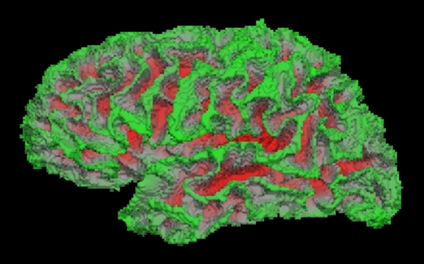
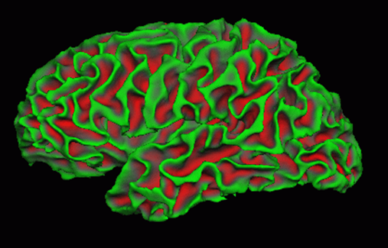
Tessellation: Voxel → Vertex
smoothing

Slide 27
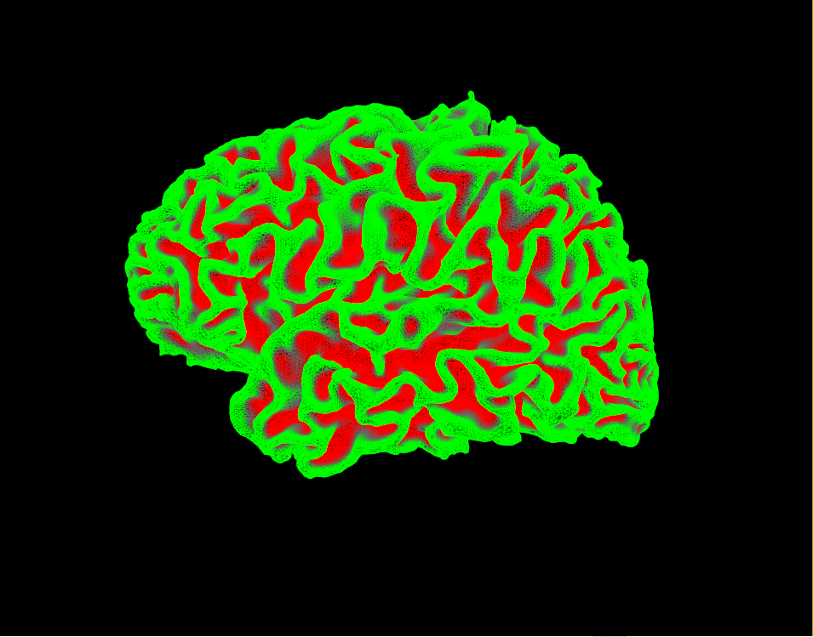
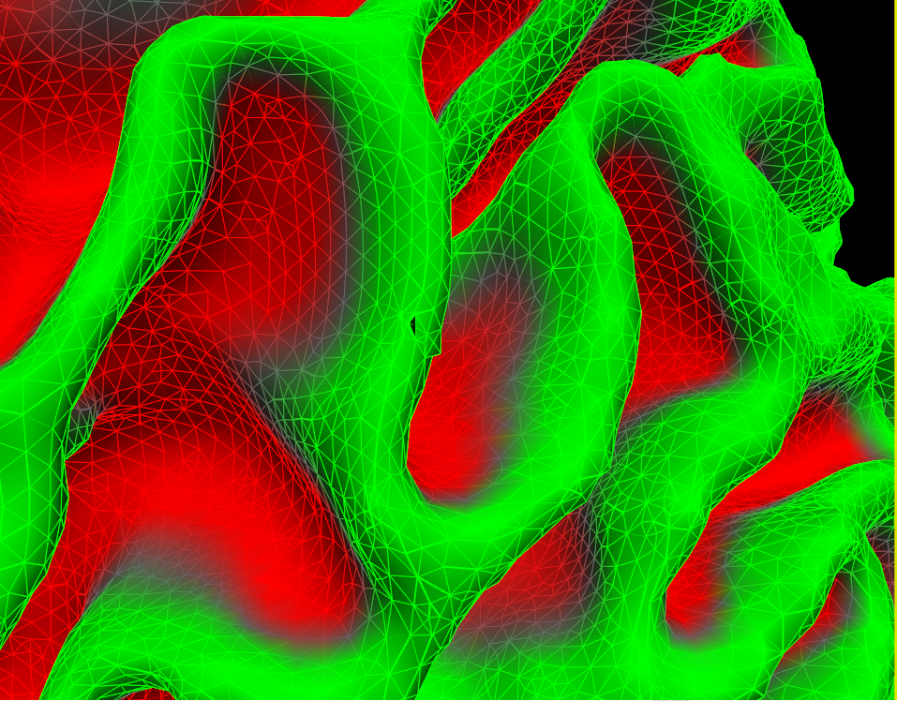
White Matter & Pial surfaces

Slide 28
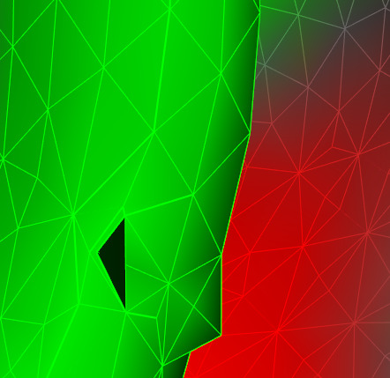
RECON: White Matter & Pial surfaces
Notes:
We can see the triangulated 3D mesh
Also a topological defect is spotted, meaning that some manual checking and correction is still required.
For my current project though, I’ll leave it as it is.

Slide 29
Collect Data 1: Surface Recon phase
Data are collected at per-vertex level
Gray matter (GM) thickness: distance from a WM vertex to the nearest Pial vertex
Local WM area: 1/3 total area of surrounding triangles
Local Volumn: area * GM thickness
Local Curvature
Notes:
Graphics are to be added later.

Slide 30
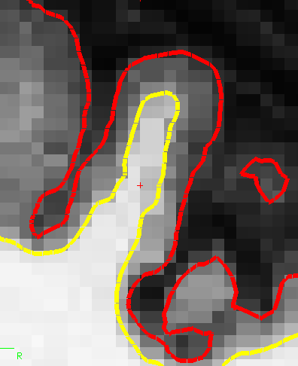
Thickness and curvature at vertex

Slide 31
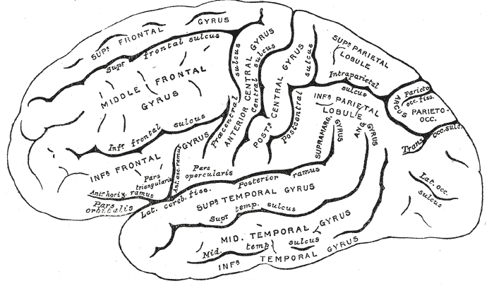
RECON: registration
We wish to compare the equivalent surface features across subjects
Yet for the equivalent structure in anatomical sense:
They have varying number of vertices
The Euclidian metrics poorly reflect geodesic metrics
Notes:
Every gyru and sulcus in a human brain is named, we wish to compare the same gyru across subjects.

Slide 32
Motivation
(L) Varying number of vertices
(R) Euclidian distance does not reflect geodesic metrics
For a vertex in A, where is the equivalent vertex in B?
Notes:
Why do we need uniformed number of vertices in an structure/region of interests?
To set up design matrix
We the geodesic metrics matters?
To unanimously assign subscript to vertices – that is, the covariate in the design matrix can be ordered

Slide 33
RECON: registration
Mapping the vertices in arbitrary brains to vertices in one universal reference brain.
Perform analysis on the reference brain instead.
Notes:
The reference brain is created by averaging 39 healthy volunteers’ brain model manually constructed from MRI by experts.

Slide 34
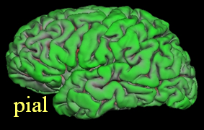
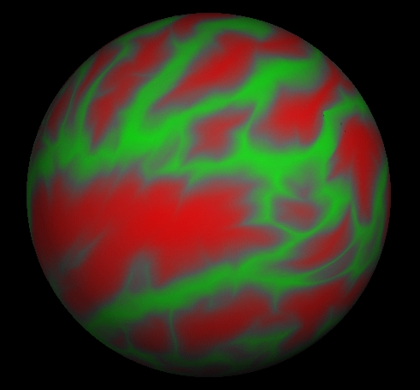
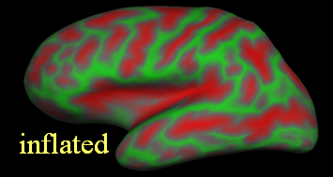
Registration: inflate to sphere
Inflate to sphere
Align to reference sphere (inflated from reference brain)
Notes:
The green-red overlay encodes surface convexity measured by vertex travel distance.
Green denotes gyru, the vertices in which do not move much during inflation
Red denote sulcus, where the vertices have to travel long distance to reach the inflated surface
Actually, the convexity is calculated on the fly during inflation process, here we cheat to demonstrate the correspondence between pre and post inflation surfaces.

Slide 35
Inflation is guiled
Minimize metric distortion:
Maintain geodesic distance between each pair of vertices in the original surface
Encourage unfolding
Notes:
The green-red overlay encodes surface convexity measured by vertex travel distance.
Green denotes gyru, the vertices in which do not move much during inflation
Red denote sulcus, where the vertices have to travel long distance to reach the inflated surface
Actually, the convexity is calculated on the fly during inflation process, here we cheat to demonstrate the correspondence between pre and post inflation surfaces.

Slide 36
Collect Data 2: inflation phase
Data is collect on per vertex level
Travel depth: how far it takes for a vertex to travel to the inflated surface
A equivalent measure of surface convexity, or sulci
vertex in sulcus: large travel depth, positive convexity
vertex in gyrus: small travel depth, negative convexity
Notes:
From freesurfer wiki:
The inflation process does not add or remove any vertices, so any data associated with the white vertices (such as curvature or convexity) is still associated with the same-numbered vertices of the sphere mesh. This is the basis of displays such as the following where a per-vertex variable "convexity" of the white surface (aka 'sulc') is plotted in color on the lh.sphere surface.

Slide 37
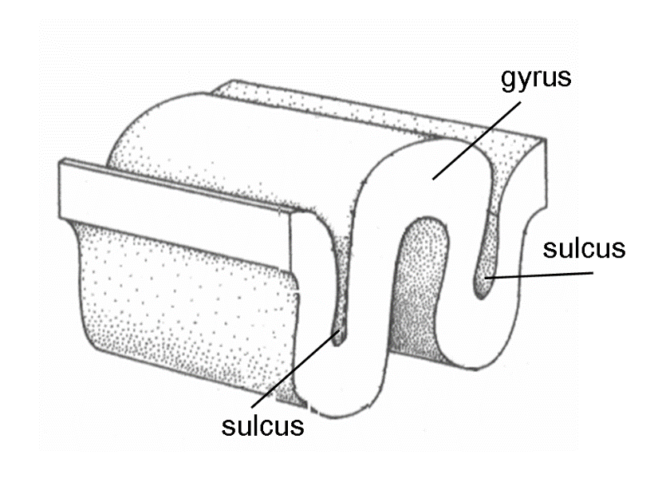
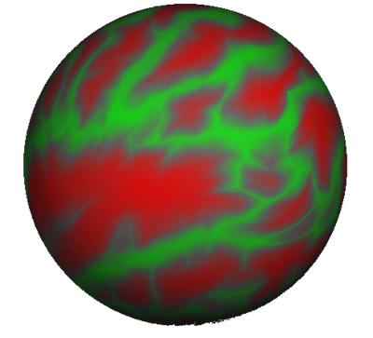
Convexity map is used for registration
Coloring
sulci (high convexity) with red
gyri (low convexity) with green

Slide 38
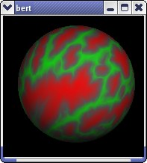
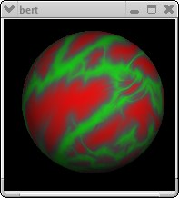
Alignment is guiled by convexity map
Minimize the convexity difference between source brain and the reference
Minimize metrics distortion due to vertex movement
Notes:
The distorted, post registration version is not that imported.
The vertex movement that align the source brain to the reference is remembered (the orange connector) so we could do the back mapping later
The reference brain is created by averaging 39 healthy volunteers’ brain model manually constructed by experts. The reference contains a fixed number of 198, 200 vertices

Slide 39
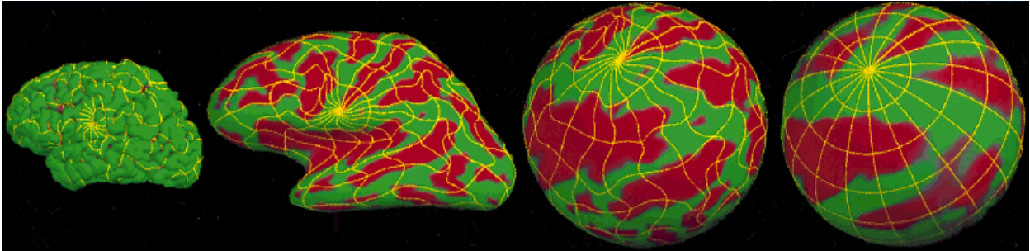
After registration: Back mapping
Pick a region in, or the whole reference brain
Lookup the corresponding vertices in the subject registered to it.
Notes:
For each vertices in the reference brain, I know the corresponding vertex in the registered subject brain
And we also retained:
The data attached to each vertices in the original brain: thickness, area, volume, local curvature, covexity
The original XYZ coordinate.

Slide 40
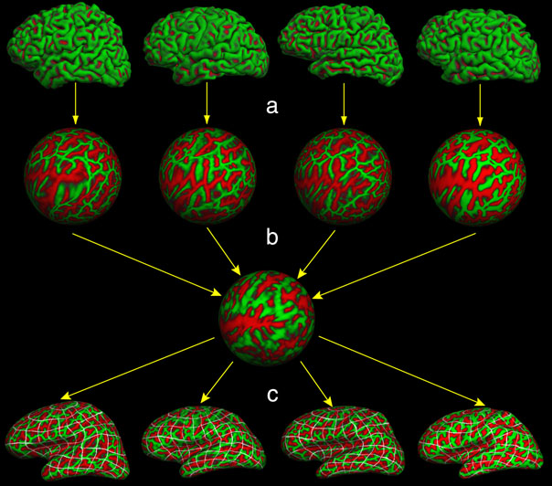
Registration: align to reference brain
Notes:
Inflation
Alignment
Back mapping
The reference brain is created by averaging 39 healthy volunteers’ brain model manually constructed by experts. The reference contains a fixed number of 198, 200 vertices

Slide 41
Back Mapping to original vertices
For each vertex in the reference brain, we know the corresponding vertex in the registered subject
The data attached to the original vertex is retained:
thickness, area, volume, local curvature
Plus the new data:
Convexity can be analyzed
And the XYZ coordinate of the original vertex
shape comparison across subject is possible

Slide 42
Image processing
Intensity
analysis
Surface
analysis
ROI
Analysis
Raw Slices
Voxels
Vertices
Labels
MRI
PROC
RECON
PAC
RECON = Surface reconstruction guided by intensity

Slide 43
Surface analysis
Imaging an association test of gray matter (GM) thickness and CNS disease risk.
V = GM thickness values of the set of vertices in the region of interest (ROI)
Y = Clinical variable
Alzheimer case / Healthy control
Cognitive score
X = Additional covariant and intercept
Demographics
Genetic variants
M = number of vertices in the ROI
N = number of subjects
Notes:
By look at the reference brain, every subject brain is now described by the identical set of vertices V, though the values attached to these vertices varying across N individuals.
The values are namely : thickness, area, …ect.

Slide 44
Surface analysis: Per vertex test
y_{i} = b_{x}x_{i}^{T} + b_{vj}v_{ij}, (i = 1, 2, … N, j = 1, 2, … M)
M times test of H₀: b_{vj} = 0
thickness at the j^{th} vertex is not associated with disease
Analytical to GWAS’s SNP screen
Low power and multiple testing
Overlook correlation among nearby vertices

Slide 45
Surface analysis: Regional Test
y_{i} = b_{x}x_{i}^{T} + b_{v}v_{i}, (v_{i} = [v_{i1}, … v_{iM}], b_{v} = [b_{v1}, … b_{vM}])
One time test of H₀: b_{v} = 0, the thickness at all vertices are unassociated with CNS disease
Curse of dimensionality:
|V| = 1638400 for one hemisphere of the reference brain
|V| = 40000+ for one anatomical region (36 per hemisphere)
Notes:
Clustered test resembles burden test for rare genetic variants

Slide 46
Surface analysis: Clustered Test
Try to solve the issues in per vertex and regional test:
y_{i} = b₀ + b_{c}x_{i} + b_{v}[w^{T}v_{i}], (w = [w₁, … w_{M}], vertex weight)
One time test of H₀: b_{v} = 0, the weighted sum of the thickness of vertices are unassociated with disease
Overlook detailed features

Slide 47
Relieve the curse of image dimensionality
Dimension reduction using unsupervised deep learning
Notes:
Here, the term image data is interchangeable with surface data and vertex data.

Slide 48
Encoder and Decoder
For a tuple of functions (F1, F2), if:
F1 takes x as input and output y
F2 takes y as input and output x’
y ≠ y but x’ = x
Then F1, F2 is called an encoder and the corresponding decoder
x is the input
y is the code
x' is the reconstruction of input

Slide 49
Encoder (and Decoder)
x (x’)
y
Encoder
Decoder
We will omit the ‘decoder’ term, since the encoders we encounter here always come with its decoder counterpart.
Encoders without programmable decoder is widely used in digital life

Slide 50
Compressive Encoder
X (Z)
Y
Encoder
Decoder
If the code y is smaller in size compared to the input x, a compression is achieved
y is holding the same amount of information with x, but lower in dimensionality
Thus dimension reduction is achieved
Notes:
Top is the lossless encoder / decoder, examples are zip, gzip, flac
Bottom is lossy encoder / decoder, examples are

Slide 51
Lossless or lossy?
x (x’)
y
Encoder
Decoder
x
x’ ≈ x
y
Encoder
Decoder
Notes:
Top is the lossless encoder / decoder, examples are:
*.* → zip, GZ
WAV/ CD → FLAC
Encryption
Bottom is lossy encoder / decoder, examples are
WAV / CD → mp3
BMP → JEPG

Slide 52
Context of Vertex data
x: a P-vector of M chinned up L-tuples, representing M vertices in the surface, P = ML.
Each L-tuple record attributes of a vertex, e.g. thickness, convexity, location.[xyz]…
y: a Q-vector of the encoded surface, Q << P
x’: a P-vector representing the surface reconstructed from encoding y
Surface x=
[x₁
x₂
…
x_{L}
x_{L+1}
x_{L+2}
…
x_{2L}
……
x_{(M-1)L+1}
x_{(M-1)L+2}
…
x_{ML}]
vertex₁
vertex₂
vertex_{M}

Slide 53
Context of Vertex data
Recon x’=
[x₁’
x₂’
…
x_{L}’
x_{L+1}’
x_{L+2}’
…
x_{2L}’
……
x_{(M-1)L+1}’
x_{(M-1)L+2}’
…
x_{P}’]^{T}
vertex₁
vertex₂
vertex_{M}
Code y=
[y₁
y₂
…
y_{Q}]
Surface x=
[x₁
x₂
…
x_{L}
x_{L+1}
x_{L+2}
…
x_{2L}
……
x_{(M-1)L+1}
x_{(M-1)L+2}
…
x_{P}]^{T}
vertex₁
vertex₂
vertex_{M}

Slide 54
The Encoder in need
High compression rate:
low dimensionality of code Y, Q << P
Low compression losses
Reconstruction X’ resembles X
The coding space metric is monotonic with the input space
Similar X produces similar Y;
Encode / decode function should be continuous
Crucial for statistical inference
Notes:
Thought about MD5 checksum, it is useless.
Encode / decode function should be continuous? Really necessary?

Slide 55
The Auto encoder Family
y = s(xw + b) ………… encoder
w: a (p, q)-matrix;
b: a q-vector
transform surface x from p-dim vertex space into coding space
x' = s(yw' + b') ………… decoder
W': a (Q, P) – matrix;
b': a P-vector;
transform y from Q-dim coding space back to vertex space
Notes:
I do not know why this type of

Slide 56
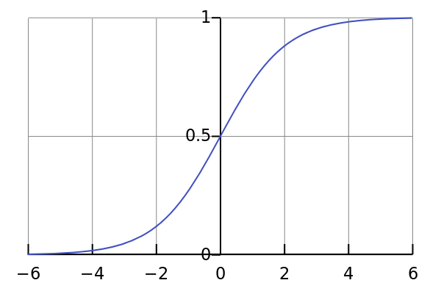
The Auto encoder Family
s(z) = 1/(1+e^{−z}) is the sigmoid function, it introduces nonlinearity into encoding and decoding transformation.
s Implies that x should be rescaled to [0, 1], since x’ is destined to be within [0, 1]
θ = {W, b, W’, b} represent an auto-encoder
"Logistic-curve" by Qef (talk) - Created from scratch with gnuplot. Licensed under Public Domain via Wikimedia Commons - https://commons.wikimedia.org/wiki/File:Logistic-curve.svg#/media/File:Logistic-curve.svg

Slide 57
[x’]=
[
x₁'
x₂'
…
…
…
x_{p}']
s(b'+yw')=
[
s
s
…
…
…
s
]_{p}
[b'|w']=
[b₁'
w₁₁'
w₁₂'
…
w_{1q}']
[b₂'
w₂₁'
w₂₂'
…
w_{2q}']
…
[b_{p}'
w_{p1}'
w_{p2}'
…
w_{pq}']
[1|y]=
[1
y₁
y₂
…
…
y_{q}
]_{1+q}
s(b+xw)=
[
s
s
…
…
s
]_{q}
…
…
…
[b|w]=
[b₁
w₁₁
w₁₂
…
w_{1p}]
[b₂
w₂₁
w₂₂
…
w_{2p}]
…
[b_{q}
w_{q1}
w_{q2}
…
w_{qp}]
…
[1|x]=
[1
x₁
x₂
…
…
…
x_{p}]
Notes:
Connecting of two elements through a line means multiply
Joining of multiple elements means summation
‘s’ means apply sigmoid function
Column bind [1] with [x] and [b] with [w] transform additive operation on b into vector product operation
I hate liner algebra

Slide 58
x_{p}’
x_{p}’
Decoder
s(.)
s(b'_{p} + (.)_{q}w'_{q×p})
b'_{p} + (.)_{q}w'_{q×p}
y_{q}
y_{q}
Encoder
s(.)
s(b_{q} + (.)_{p}w_{p×q})
b_{q} + (.)_{p}w_{p×q}
x_{p}
x_{p}
Notes:
Simplified notation.
Bar width represent input dimension
Circle indicate element-wise operation
Subscript denote vector and matrix dimension

Slide 59
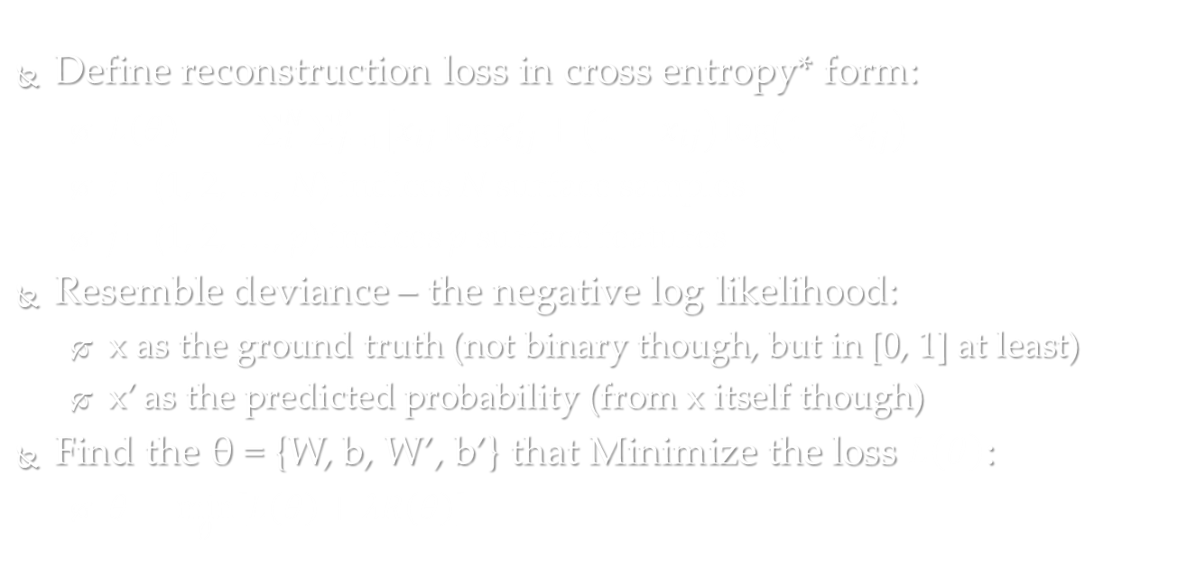
Build an Autoencoder
Define reconstruction loss in cross entropy* form:
$L\left(θ\right)=−\sum_{i}^{N}{\sum_{j=1}^{P}{\left[x_{ij}\log{x_{ij}^{′}}+\left(1−x_{ij}\right)\log\left(1−x_{ij}^{′}\right)\right]}}$
i = (1, 2, …, N) indices N surface samples
j = (1, 2, …, p) indices p surface features
Resemble deviance – the negative log likelihood:
x as the ground truth (not binary though, but in [0, 1] at least)
x’ as the predicted probability (from x itself though)
Find the θ = {W, b, W’, b’} that Minimize the loss $L\left(θ\right)$:
$θ=\min_{θ}\left[L\left(θ\right)+λR\left(θ\right)\right]$
Notes:
Build a encoder mean find the best /theta.
By best we mean the /theta that minimize reconstruction loses.
Intuitively, a nice encoding method should have high compression ratio, and able to restore input completely.
How about an Identity mapping from x to y, and y to x’, to reach perfect “reconstruction” and 0 deviance?
That is, Y= X, and X’ = Y ?
It is impossible because Y has a dimension Q << P, the dimension of X.
*Might change the loss function since x is not binary. Gaussian distance between x and x’ may be a choice.

Slide 60
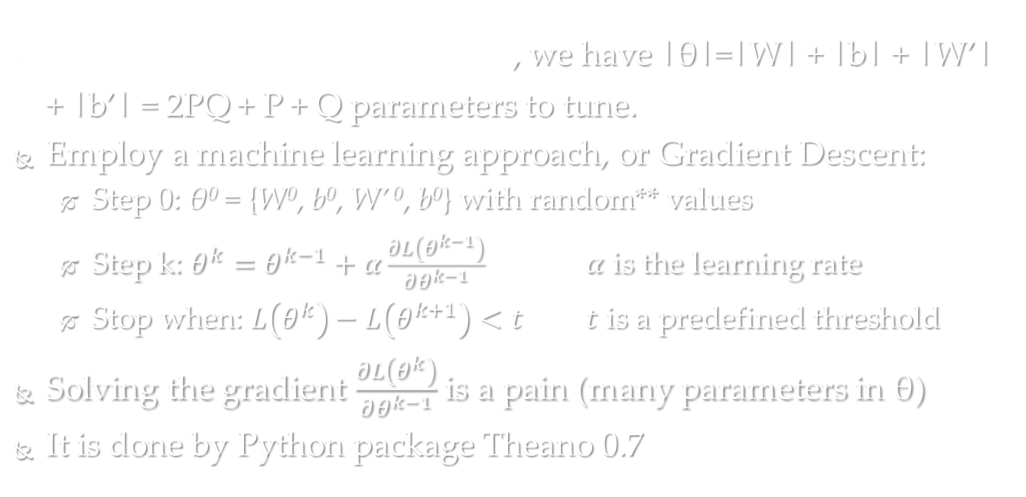
Build an Autoencoder
To solve $θ=\min_{θ}\left[L\left(θ\right)+λR\left(θ\right)\right]$, we have |θ|=|W| + |b| + |W’| + |b’| = 2PQ + P + Q parameters to tune.
Employ a machine learning approach, or Gradient Descent:
Step 0: θ⁰ = {W⁰, b⁰, W’ ⁰, b⁰} with random** values
Step k: $θ^{k}=θ^{k−1}+α\frac{∂L\left(θ^{k−1}\right)}{∂θ^{k−1}}$ $α$ is the learning rate
Stop when: $L\left(θ^{k}\right)−L\left(θ^{k+1}\right)<t$ $t$ is a predefined threshold
Solving the gradient $\frac{∂L\left(θ^{k}\right)}{∂θ^{k−1}}$ is a pain (many parameters in θ)
It is done by Python package Theano 0.7
Notes:
**There are some current best practice of initial value settings.

Slide 61
Build deep network

Slide 62
Why do we need deep network?
A single coding layer could in theory span a family of functions as rich as a multi-layered network
However, the amount of parameters required to reach equivalent richness increases exponentially* with the number of layers, compromising dimension reduction
With the same amount of parameters, (e.g. 2pq + p + q of a simple autoencoder), a deep network can modulate function of more arbitrary shapes
Larger function space mean higher chance to find optimal encoder and decoder.
Notes:
Sorry I couldn’t demonstrate a quantitative measure for now.
a two layered n + n network can represent as many as O(e²) more functions than a single layered n-network – my understanding

Slide 63
Stacked Auto Encoder (SA)
Layers of auto encoders stacking over each other
Coding from lower layer pipe into to higher layer as input
Decoding from higher layer flow into lower layer as decoding input
For practical purpose, dimensionality decreases as the layer stacking up.

Slide 64
x_{r-1}'
s(b_{r}' + (.)w_{r}')
x_{r}
s(b_{r} + (.)w_{r})
x_{r-1}
s(b_{r-1}' + (.)w_{r-1}')
x_{r-2}’
s(b_{r-1} + (.)w_{r-1})
x₂'
… …
x_{r-2}
s(b₃ + (.)w₃)
x₂
s(b₂' + (.)w₂')
x₁’
s(b₂ + (.)w₂)
x₀’
s(b'₁ + (.)w'₁)
x₁
s(b₁ + (.)w₁)
x₀
A staked autoencoder (SA) of r layers

Slide 65
x_{r-1}'
s(b_{r}' + (.)w_{r}')
x_{r}
A_{r}
s(b_{r} + (.)w_{r})
x_{r-1}
s(b_{r-1}' + (.)w_{r-1}')
x_{r-2}’
A_{r-1}
s(b_{r-1} + (.)w_{r-1})
x₂'
… …
x_{r-2}
s(b₃ + (.)w₃)
x₂
s(b₂' + (.)w₂')
x₁’
A₂
s(b₂ + (.)w₂)
x₀’
s(b'₁ + (.)w'₁)
x₁
A₁
s(b₁ + (.)w₁)
x₀
Notes:
Squeeze them a bit to conserve space
Subscript denote layer
s : sigmoid function

Slide 66
x_{r-1}'
s(b_{r}' + (.)w_{r}')
x_{r}
A_{r}
s(b_{r} + (.)w_{r})
x_{r-1}
s(b_{r-1}' + (.)w_{r-1}')
x_{r-2}’
A_{r-1}
s(b_{r-1} + (.)w_{r-1})
x₂'
… …
x_{r-2}
s(b₃ + (.)w₃)
x₂
s(b₂' + (.)w₂')
x₁’
A₂
s(b₂ + (.)w₂)
x₀’
s(b'₁ + (.)w'₁)
x₁
A₁
s(b₁ + (.)w₁)
x₀
Notes:
Red lines denote encoding pipeline
Yellow lines denote decoding (reconstruction pipeline)
x₀ is the raw input, representing ground truth
x_{r} is the final code, with lowest dimensionality
starting from x_{r}, though a series of decoding (reconstruction), we get x₀’, is the final reconstruction,
supposedly closely resemble x₀.
x_{r} can be viewed as prediction of x₀ to define encoding loss.
Prime denote decoding output / reconstrutions

Slide 67
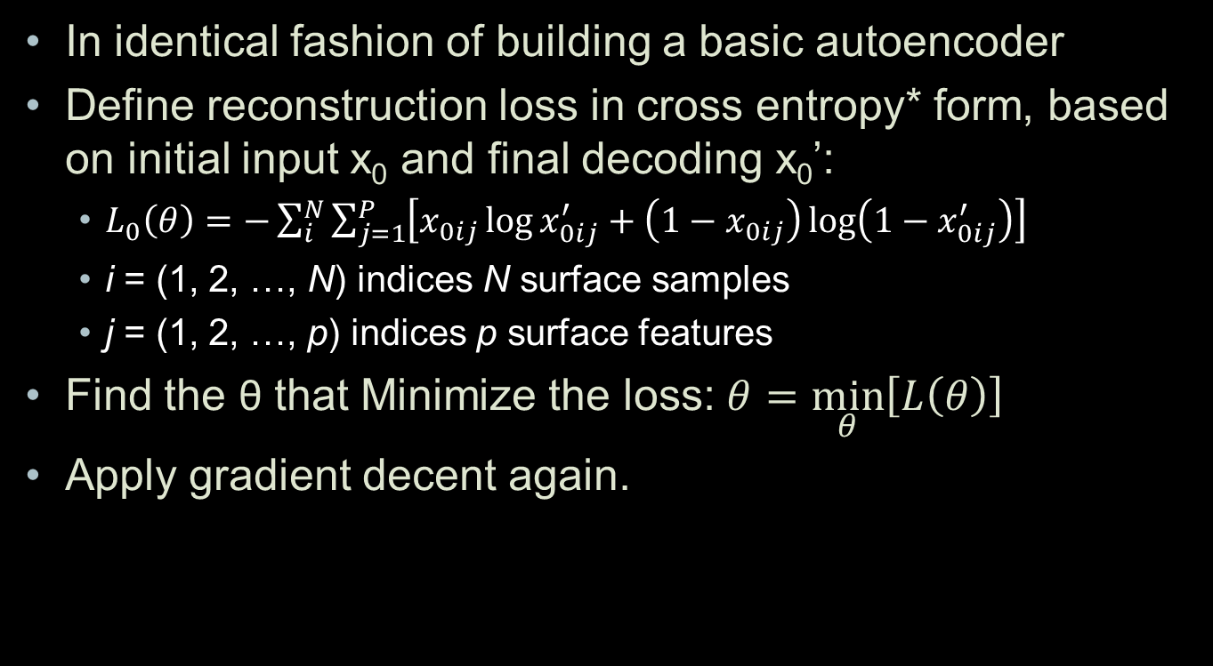
Build an SA of r layers
In identical fashion of building a basic autoencoder
Define reconstruction loss in cross entropy* form, based on initial input x₀ and final decoding x₀’:
$L_{0}\left(θ\right)=−\sum_{i}^{N}{\sum_{j=1}^{P}{\left[x_{0ij}\log{x_{0ij}^{′}}+\left(1−x_{0ij}\right)\log\left(1−x_{0ij}^{′}\right)\right]}}$
i = (1, 2, …, N) indices N surface samples
j = (1, 2, …, p) indices p surface features
Find the θ that Minimize the loss: $θ=\min_{θ}\left[L\left(θ\right)\right]$
Apply gradient decent again.

Slide 68

x_{r-1}'
s(b_{r}' + (.)w_{r}')
x_{r}
A_{r}
s(b_{r} + (.)w_{r})
x_{r-1}
s(b_{r-1}' + (.)w_{r-1}')
x_{r-2}’
A_{r-1}
s(b_{r-1} + (.)w_{r-1})
x₂'
… …
x_{r-2}
s(b₃ + (.)w₃)
x₂
s(b₂' + (.)w₂')
x₁’
A₂
s(b₂ + (.)w₂)
x₀’
s(b₁' + (.)w₁')
x₁
A₁
$$L\left(θ\right)$$
s(b₁ + (.)w₁)
x₀
Notes:
x_{r} can be viewed as prediction of x₀ to define encoding loss and train the SD.
But tune the whole machine is risky and slow.
In real practice the first layer is usually over fitted, meaning the scale of W1 and b1 is even larger then the input x0.
Actually we have to reduce the learn rate alpha, otherwise the learning curve is unstable

Slide 69
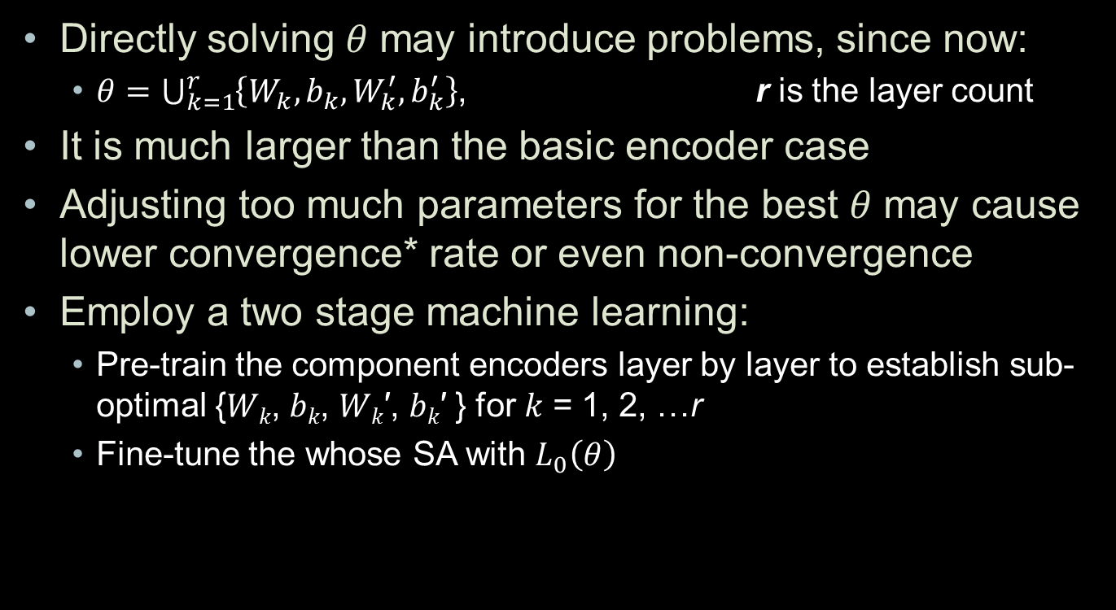
Build an SA of r layers
Directly solving 𝜃 may introduce problems, since now:
$θ=\bigcup_{k=1}^{r}{\left\{W_{k}, b_{k}, W_{k}^{′}, b_{k}^{′}\right\}}$, r is the layer count
It is much larger than the basic encoder case
Adjusting too much parameters for the best 𝜃 may cause lower convergence* rate or even non-convergence
Employ a two stage machine learning:
Pre-train the component encoders layer by layer to establish sub-optimal {𝑊_{𝑘}, 𝑏_{𝑘}, 𝑊_{𝑘}′, 𝑏_{𝑘}′ } for 𝑘 = 1, 2, …r
Fine-tune the whose SA with $L_{0}\left(θ\right)$
Notes:
In real practice the first layer is usually over fitted, meaning the scale of W1 and b1 is even larger then the input x0.
Actually we have to reduce the learn rate alpha, otherwise the learning curve is unstable

Slide 70
x_{r-1}'
s(b_{r}' + (.)w_{r}')
x_{r}
A_{r}
s(b_{r} + (.)w_{r})
x_{r-1}
s(b_{r-1}' + (.)w_{r-1}')
x_{r-2}’
A_{r-1}
s(b_{r-1} + (.)w_{r-1})
x₂'
… …
x_{r-2}
s(b₃ + (.)w₃)
x₂
s(b₂' + (.)w₂')
x₁’
A₂
s(b₂ + (.)w₂)
x₀’
s(b'₁ + (.)w'₁)
x₁
A₁
s(b₁ + (.)w₁)
x₀
Notes:
Stop waiting for the final decoding x0’, unwire all upper to lower connection in decoding / reconstruction pipeline.
But do keep the within layer decoding pipe.

Slide 71
x_{r-1}'
s(b_{r}' + (.)w_{r}')
x_{r}
A_{r}
s(b_{r} + (.)w_{r})
x_{r-1}
s(b_{r-1}' + (.)w_{r-1}')
x_{r-2}’
A_{r-1}
s(b_{r-1} + (.)w_{r-1})
x₂'
… …
x_{r-2}
s(b₃ + (.)w₃)
x₂
s(b₂' + (.)w₂')
x₁’
A₂
s(b₂ + (.)w₂)
x₀’
s(b'₁ + (.)w'₁)
x₁
A₁
s(b₁ + (.)w₁)
x₀
Notes:
Instead of sending encoded output to the layer up, first wire the compressed code back to current layer’s decoder immediately, and capture the locally reconstructed input.
Adjust current layer’s parameters with cross entropy of the local input and reconstruction.

Slide 72

x_{r-1}'
s(b_{r}' + (.)w_{r}')
x_{r}
s(b_{r} + (.)w_{r})
x_{r-1}
s(b_{r-1}' + (.)w_{r-1}')
x_{r-2}’
s(b_{r-1} + (.)w_{r-1})
x₂'
… …
x_{r-2}
s(b₃ + (.)w₃)
x₂
s(b₂' + (.)w₂')
x₁’
s(b₂ + (.)w₂)
x₀’
s(b'₁ + (.)w'₁)
x₁
$$L_{1}\left(θ_{1}\right)$$
s(b₁ + (.)w₁)
x₀
Notes:
Train the simple autoencoder now.

Slide 73

x_{r-1}'
s(b_{r}' + (.)w_{r}')
x_{r}
s(b_{r} + (.)w_{r})
x_{r-1}
s(b_{r-1}' + (.)w_{r-1}')
x_{r-2}’
s(b_{r-1} + (.)w_{r-1})
x₂'
… …
x_{r-2}
s(b₃ + (.)w₃)
x₂
s(b₂' + (.)w₂')
x₁’
s(b₂ + (.)w₂)
$$L_{2}\left(θ_{2}\right)$$
x₀’
s(b'₁ + (.)w'₁)
x₁
s(b₁ + (.)w₁)
x₀
Notes:
After adjusting the previous layer (1st), unwire the local decoding (yellow) and connect the code to upper layer’s (2nd) encoder (red line)
Do the same unwiring and rewiring for layer 2nd, then turn its parameters.

Slide 74

x_{r-1}'
s(b_{r}' + (.)w_{r}')
x_{r}
s(b_{r} + (.)w_{r})
x_{r-1}
s(b_{r-1}' + (.)w_{r-1}')
x_{r-2}’
s(b_{r-1} + (.)w_{r-1})
x₂'
… …
x_{r-2}
$$L_{3}\left(θ_{3}\right)$$
s(b₃ + (.)w₃)
x₂
s(b₂' + (.)w₂')
x₁’
s(b₂ + (.)w₂)
x₀’
s(b'₁ + (.)w'₁)
x₁
s(b₁ + (.)w₁)
x₀

Slide 75

x_{r-1}'
s(b_{r}' + (.)w_{r}')
x_{r}
s(b_{r} + (.)w_{r})
x_{r-1}
s(b_{r-1}' + (.)w_{r-1}')
x_{r-2}’
s(b_{r-1} + (.)w_{r-1})
$$L_{r−1}\left(θ_{r−1}\right)$$
x₂'
… …
x_{r-2}
s(b₃ + (.)w₃)
x₂
s(b₂' + (.)w₂')
x₁’
s(b₂ + (.)w₂)
x₀’
s(b'₁ + (.)w'₁)
x₁
s(b₁ + (.)w₁)
x₀

Slide 76

x_{r-1}'
s(b_{r}' + (.)w_{r}')
x_{r}
$$L_{r}\left(θ_{r}\right)$$
s(b_{r} + (.)w_{r})
x_{r-1}
s(b_{r-1}' + (.)w_{r-1}')
x_{r-2}’
s(b_{r-1} + (.)w_{r-1})
x₂'
… …
x_{r-2}
s(b₃ + (.)w₃)
x₂
s(b₂' + (.)w₂')
x₁’
s(b₂ + (.)w₂)
x₀’
s(b'₁ + (.)w'₁)
x₁
s(b₁ + (.)w₁)
x₀

Slide 77
x_{r-1}'
s(b_{r}' + (.)w_{r}')
x_{r}
A_{r}
s(b_{r} + (.)w_{r})
x_{r-1}
s(b_{r-1}' + (.)w_{r-1}')
x_{r-2}’
A_{r-1}
s(b_{r-1} + (.)w_{r-1})
x₂'
… …
x_{r-2}
s(b₃ + (.)w₃)
x₂
s(b₂' + (.)w₂')
x₁’
A₂
s(b₂ + (.)w₂)
x₀’
s(b₁' + (.)w₁')
x₁
A₁
$$L\left(θ\right)$$
s(b₁ + (.)w₁)
x₀
Notes:
Now wire back all inter-layer reconstruction / decoding pipelines
Fine turn the whole machine – adjust all parameters now.

Slide 78
x_{r}
A_{r}
s(b_{r} + (.)w_{r})
x_{r-1}
A_{r-1}
s(b_{r-1} + (.)w_{r-1})
… …
x_{r-2}
s(b₃ + (.)w₃)
x₂
A₂
s(b₂ + (.)w₂)
x₁
A₁
s(b₁ + (.)w₁)
x₀
Notes:
At last all we need is the encoding pipeline.
Just realize half of my parameters are only for the other half…

Slide 79
x_{r}
A_{r}
s(b_{r} + (.)w_{r})
A_{r-1}
s(b_{r-1} + (.)w_{r-1})
… …
s(b₃ + (.)w₃)
A₂
s(b₂ + (.)w₂)
A₁
s(b₁ + (.)w₁)
x₀
Notes:
At last all we need is the encoding pipeline.
Just realize half of my parameters are only for the other half…
And all the intermediate encoding is not necessary.

Slide 80
x_{r}
SA_{q×p}
x₀
Notes:
We will use this condensed reorientation later

Slide 81
association analysis of genetic, image & disease
A Mann–Whitney U test of multiple kernels

Slide 82
Build kernels for 3 types of data
Genetic kernel
Dosage WGS data
Image kernel
Encoded vertex data
Covariant kernel
Typical demographic info and clinical measurement
Weighted identity by state (wIBS) kernel
Gaussian kernel
Standard Normal kernel
Measure genetic similarity
Measure cortical surface similarity
Measure similarity regarding these covariant

Slide 83
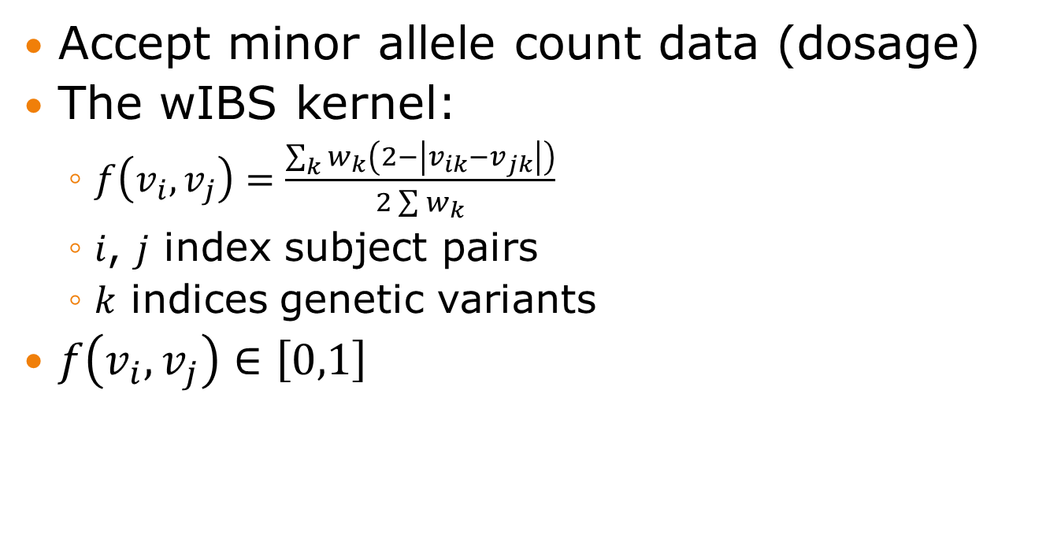
1) U kernel for WGS data
Accept minor allele count data (dosage)
The wIBS kernel:
$f\left(v_{i},v_{j}\right)=\frac{\sum_{k}{w_{k}\left(2−\left|v_{ik}−v_{jk}\right|\right)}}{2\sum{w_{k}}}$
𝑖, 𝑗 index subject pairs
𝑘 indices genetic variants
$f\left(v_{i},v_{j}\right)∈\left[0,1\right]$

Slide 84
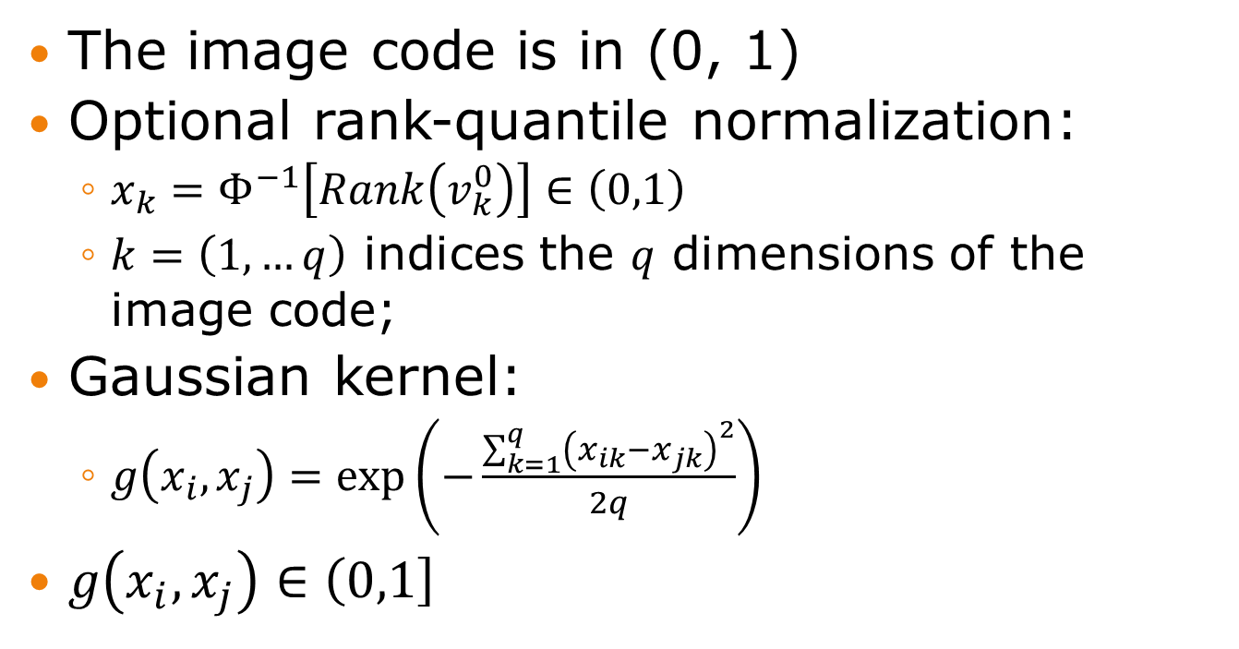
2) U kernel for Image code
The image code is in (0, 1)
Optional rank-quantile normalization:
$x_{k}=Φ^{−1}\left[Rank\left(v_{k}^{0}\right)\right]∈\left(0,1\right)$
$k=\left(1,…q\right)$ indices the 𝑞 dimensions of the image code;
Gaussian kernel:
$g\left(x_{i},x_{j}\right)=\exp\left(−\frac{\sum_{k=1}^{q}{{\left(x_{ik}−x_{jk}\right)}^{2}}}{2q}\right)$
$g\left(x_{i},x_{j}\right)∈\left(0,1\right]$
Notes:
Current image code dimension is 8~16

Slide 85
Variant weighting schemes
Uniform:
w_{k} = 1
MAF SD inversed:
w_{k} = 1/[MAF_{k}(1-MAF_{k})]^{1/2}
Negative log MAF:
w_{k} = -log₁₀MAF_{k}

Slide 86
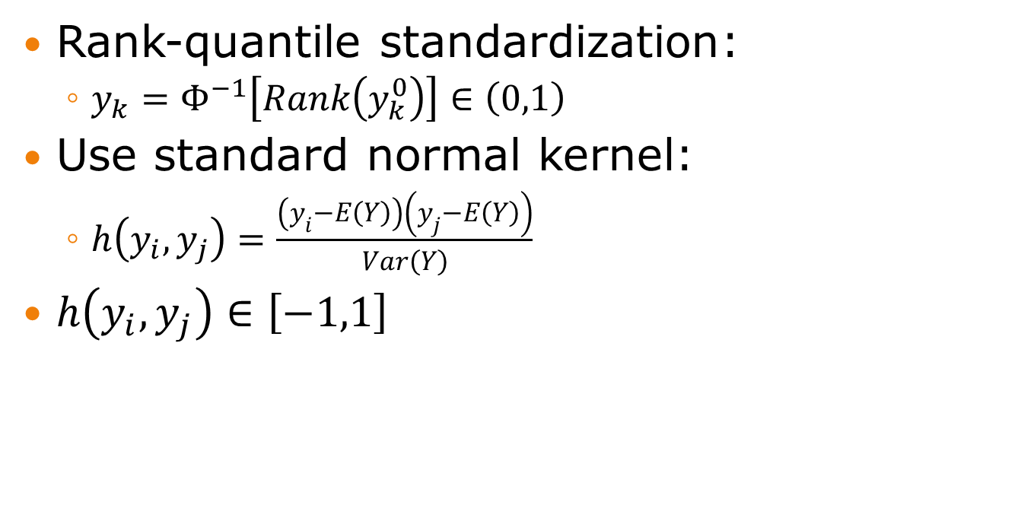
3) U kernel for covariate
Rank-quantile standardization:
$y_{k}=Φ^{−1}\left[Rank\left(y_{k}^{0}\right)\right]∈\left(0,1\right)$
Use standard normal kernel:
$h\left(y_{i},y_{j}\right)=\frac{\left(y_{i}−E\left(Y\right)\right)\left(y_{j}−E\left(Y\right)\right)}{Var\left(Y\right)}$
$h\left(y_{i},y_{j}\right)∈\left[−1,1\right]$
Notes:
I’m not sure of h_{ij} distribution.
A chi-square if y is a normal.

Slide 87
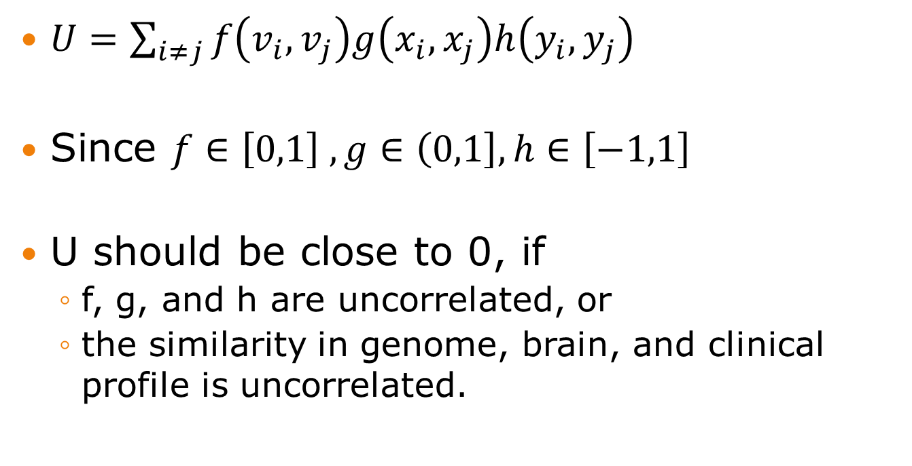
Build U statistics
$U=\sum_{i≠j}{f\left(v_{i},v_{j}\right)g\left(x_{i},x_{j}\right)h\left(y_{i},y_{j}\right)}$
Since $f∈\left[0,1\right] , g∈\left(0,1\right], h∈\left[−1,1\right]$
U should be close to 0, if
f, g, and h are uncorrelated, or
the similarity in genome, brain, and clinical profile is uncorrelated.

Slide 88
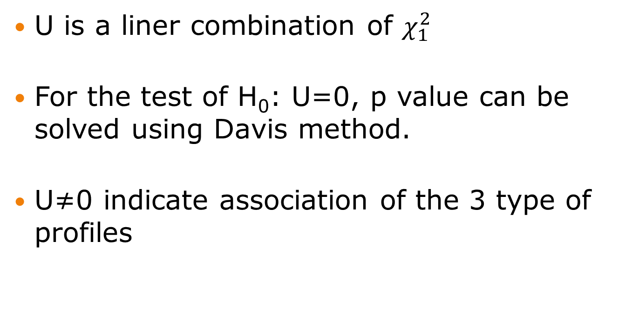
Test U against 0
U is a liner combination of $χ_{1}^{2}$
For the test of H₀: U=0, p value can be solved using Davis method.
U≠0 indicate association of the 3 type of profiles
Notes:
Changeshuai did the proof
And the U test code.

Slide 89





$$U$$
$$=$$
$$f\left(v_{i},v_{j}\right)$$
$$g\left(x_{i},x_{j}\right)$$
$$h\left(y_{i},y_{j}\right)$$
v
x
y
clean
SA_{q×p}
clean
Variant Call
RECON
Alignment
PROC
WGS
Reads
MRI
Slices
Clinical
Profile

